Slide 1
Artificial Intelligence for Games Week 9 – Indirect Learning 2 Steve Rabin
For help on projects, email everyone (select and copy this string from the start of any class PowerPoint):
steve.rabin@gmail.com, p.jiankai@digipen.edu, b.hsu@digipen.edu, zak.s@digipen.edu, keaton.sullivan@digipen.edu, john.tseng@digipen.edu, a.roulst@digipen.edu
TAs: Jian Kai Phua, Brandon Hsu, Zak Stephenson, Keaton Sullivan, John Tseng, Andrew Roulst

Slide 2
Questions
How can you fake learning?
Describe the difference between Indirect and Direct Adaptation.
Using a Bi-Gram, find the probabilities for possible next actions in the following sequence:
kick, punch, kick, sideswipe, punch, kick, kick, kick, punch, punch, kick, kick, punch, kick, …

Slide 3
Speed Contest Winners
Student | Time | Sample Time | Ratio
Jiawei Jarrett ANG | 601 | 2573 | 0.233579
Cj J Sweatt | 657 | 2573 | 0.255344
Jaasmeet SINGH | 791 | 2573 | 0.307423
Jun Lin Wayne GOH | 808 | 2573 | 0.31403

Slide 4
Moving Averages

Slide 5
Moving Averages RTS: How many minutes before players attacks?

Slide 6
Moving Averages RTS: How many minutes before players attacks?
Sequence | Avg | Med
10

Slide 7
Moving Averages RTS: How many minutes before players attacks?
Sequence | Avg | Med
25 10

Slide 8
Moving Averages RTS: How many minutes before players attacks?
Sequence | Avg | Med
7 25 10

Slide 9
Moving Averages RTS: How many minutes before players attacks?
Sequence | Avg | Med
3 7 25 10

Slide 10
Moving Averages RTS: How many minutes before players attacks?
Sequence | Avg | Med
12 3 7 25 10

Slide 11
Moving Averages RTS: How many minutes before players attacks?
Sequence | Avg | Med
4 12 3 7 25 10

Slide 12
Moving Averages RTS: How many minutes before players attacks?
Sequence | Avg | Med
9 4 12 3 7 25 10

Slide 13
Moving Averages RTS: How many minutes before players attacks?
Sequence | Avg | Med
8 9 4 12 3 7 25 10

Slide 14
Moving Averages RTS: How many minutes before players attacks?
Sequence | Avg | Med
2 8 9 4 12 3 7 25 10

Slide 15
Moving Averages RTS: How many minutes before players attacks?
Sequence | Avg | Med
5 2 8 9 4 12 3 7 25 10

Slide 16
Moving Averages RTS: How many minutes before players attacks?
Sequence | Avg | Med
5 2 8 9 4 12 3 7 25 10 | 8.5

Slide 17
Moving Averages RTS: How many minutes before players attacks?
Sequence | Avg | Med
5 2 8 9 4 12 3 7 25 10 | 8.5 | 7.5

Slide 18
Moving Averages RTS: How many minutes before players attacks?
Sequence | Avg | Med
5 2 8 9 4 12 3 7 25 10 | 8.5 | 7.5
1 5 2 8 9 4 12 3 7 25 10 | 7.8 | 7.0

Slide 19
Moving Averages RTS: How many minutes before players attacks?
Sequence | Avg | Med
5 2 8 9 4 12 3 7 25 10 | 8.5 | 7.5
1 5 2 8 9 4 12 3 7 25 10 | 7.8 | 7.0
3 1 5 2 8 9 4 12 3 7 25 10 | 7.4 | 6.0

Slide 20

Moving Average Window RTS: How many minutes before players attacks?
Sequence | Avg | Med
5 2 8 9 4 12 3 7 25 10 | 8.5 | 7.5

Slide 21
Moving Average Window RTS: How many minutes before players attacks?
Sequence | Avg | Med
5 2 8 9 4 12 3 7 25 10 | 8.5 | 7.5
1 5 2 8 9 4 12 3 7 25 10 | 7.6 | 6.0

Slide 22
Moving Average Window RTS: How many minutes before players attacks?
Sequence | Avg | Med
5 2 8 9 4 12 3 7 25 10 | 8.5 | 7.5
1 5 2 8 9 4 12 3 7 25 10 | 7.6 | 6.0
3 1 5 2 8 9 4 12 3 7 25 10 | 5.4 | 4.5

Slide 23
Sequence | Avg | Med
5 2 8 9 4 12 3 7 25 10 | 8.5 | 7.5
1 5 2 8 9 4 12 3 7 25 10 | 7.8 | 7.0
3 1 5 2 8 9 4 12 3 7 25 10 | 7.4 | 6.0
Sequence (moving average window) | Avg | Med
5 2 8 9 4 12 3 7 25 10 | 8.5 | 7.5
1 5 2 8 9 4 12 3 7 25 10 | 7.6 | 6.0
3 1 5 2 8 9 4 12 3 7 25 10 | 5.4 | 4.5

Slide 24
Moving Average Equation
newAvg = α · newObservation + (1- α) · avg
α = Learning rate (usually equal to 1/n)
α = 0.05 if changes are common
α = 0.01 if changes are rare

Slide 25
Moving Average Equation
newAvg = α · newObservation + (1- α) · avg
α = 0.01 5.05 = 0.01 · 10.0 + (0.99) · 5.0
α = 0.10 5.50 = 0.10 · 10.0 + (0.90) · 5.0
α = 0.50 7.50 = 0.50 · 10.0 + (0.50) · 5.0

Slide 26

Detecting Changes
The player might change behavior
How do you detect this?
Have two moving average equations
Moving average window (10 observations)
Moving average window (20 observations)
Do they agree?

Slide 27
Estimating Extreme Values
Extreme values represent risk
Game designer:
“AI should be caught off-guard 1 out of 5 times”
3 8 1 4 9 13 5 7 6 4
1 3 4 4 5 6 7 8 9 13

Slide 28
Player Modeling

Slide 29

Player Modeling
Model the player’s behavior
Record frequency of actions
Use stats to make game harder or easier
Adapt to better counter player moves (harder)
Adapt to be more susceptible to player moves (easier)
Alternative: Manually set difficulty levels

Slide 30
Player Modeling
Record the player’s
Skills
Weaknesses
Preferences
Dislikes

Slide 31
Player Modeling
We call the recorded values traits
Traits are ideally in the range [0,1]

Slide 32
Brainstorm some RTS Traits
RTS traits
AvoidsMovingThroughEnemyChokepoints
AttacksOnTwoFronts
PrefersGroundForces

Slide 33
Brainstorm some FPS Traits
FPS traits
UsesSmokeGrenades
AlwaysRuns
CanDoTrickyJumps

Slide 34
Consider Trait Meanings
Trait: SmokeGrenades
Could mean:
Skill (skilled at using smoke grenades)
Preference (often uses smoke grenades)
Better names for each?

Slide 35
Fine Grained vs. Coarse
Fine grained is:
Costly to design and develop
Costly to compute
Lack of evidence
PrefersSmokeGrenades
GoodAtSmokeGrenades
Fine grained examples:
While retreating
While entering building
While covering teammate

Slide 36
Player Modeling Tips
Make a list of things to record about the player
Estimate collection difficulty
Estimate usefulness
Record stats that you want to show the player
Record stats that will be useful for the AI
If the AI is not designed yet:
Define player model and build strategies to exploit it

Slide 37
Player Modeling: How do you actually architect it?
Centralize the storage of traits
Notify storage when events happen
From the easiest places to observe
Might get messy…
Make query functions for the AI

Slide 38
Player Modeling Examples
Make the game harder
Use as predictive tool (skills)
If AI wants to attack player with a wizard, and player frequently kills wizards with a ranged attack, wizard could preemptively cast spell to protect against ranged attacks
Look for player weaknesses to exploit
If player lousy at defending against roundhouse kick, then pick that move more often
Look for player skills to defend against
If player always picks up health, try to starve them of it

Slide 39
Player Modeling Examples
Make the game easier
Avoid exploiting player weaknesses
If player never gets shield, don't get shield yourself
Can you make the game easier or harder knowing
Preferences?
Dislikes?

Slide 40
Hierarchical Player Models
Stealthy Trait (abstract)
Geometric Mean of
AvoidsCameras (concrete)
AvoidsGuards (concrete)
MovesSilently (concrete)
If “Stealthy Trait” high
Make guards more watchful

Slide 41
Other Uses for Player Modeling
Expose model to player
Becomes part of gameplay (Fable)
Player manipulates the model
Help the player by pointing out things they aren’t doing/exploiting
Fancy AI help system

Slide 42
Sci-Fi Factoid Intermission Theater

Slide 43
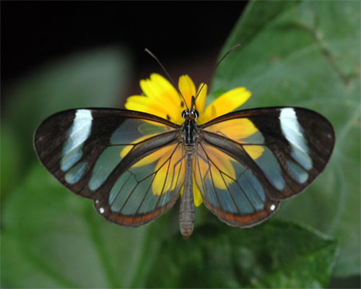
The Butterfly Effect
Small variations of the initial condition of a dynamical system may produce large variations in long term behavior
“Sensitive dependence upon initial conditions”
– Edward Lorenz
(pioneer of chaos theory, coined "butterfly effect")

Slide 44
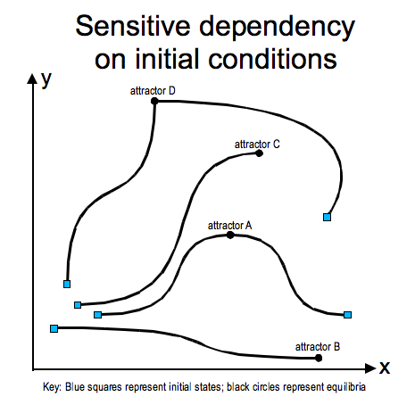

Slide 45
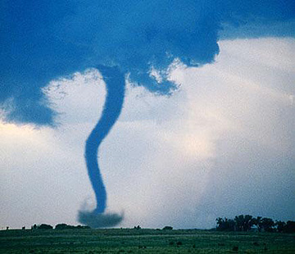
The Butterfly Effect
“Sound of Thunder” (Ray Bradbury 1952)
Killing of a butterfly during the time of the dinosaurs causes the future to change in subtle but meaningful ways
A butterfly’s wings on one side of the earth causes tiny changes in the atmosphere that years later causes a tornado to appear on the other side of the earth

Slide 46
Economic Factoid Intermission Theater

Slide 47
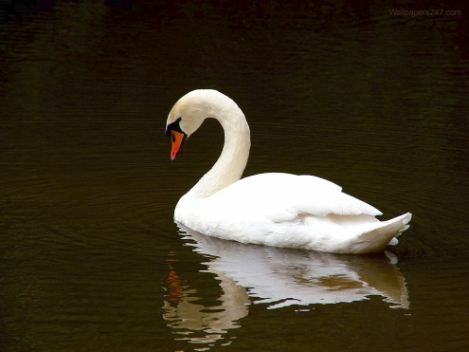
White Swans and Black Swans
The earliest mention of a “black swan” is by a Roman poet in the late 1st century
In 16th century London, a “black swan” was something that was impossible or non-existent
No one had ever seen a black swan…

Slide 48
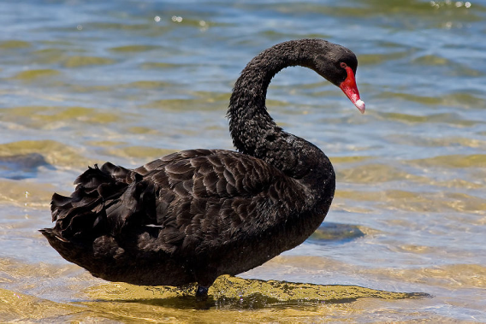
Black Swans
In 1697, black swans were discovered in Western Australia by a Dutch expedition
The term changed:
A perceived impossibility might later be disproven

Slide 49
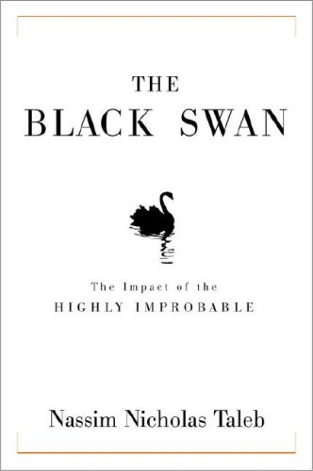
A Black Swan Event
It is an Outlier
Nothing in the past can convincingly point to its possibility
It has an Extreme Impact
It seems Retrospectively Predictable
We concoct explanations for its occurrence after the fact

Slide 50
Black Swan Events in History
The rise of the Internet
Personal computers
World War I
9/11
Penicillin
Human beings
How do you predict a black swan event?

Slide 51
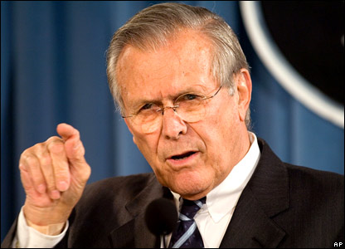
Unknown Unknowns
“There are known knowns; there are things we know that we know.
There are known unknowns; that is to say, there are things that we now know we don’t know.
But there are also unknown unknowns; there are things we do not know we don’t know.”

Slide 52
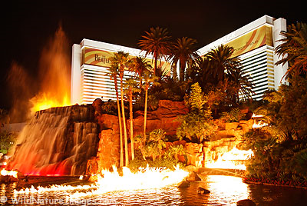
Las Vegas Casino
Risks…
What are the Known Knowns?
What are Known Unknowns?
What would be an Unknown Unknown?

Slide 53
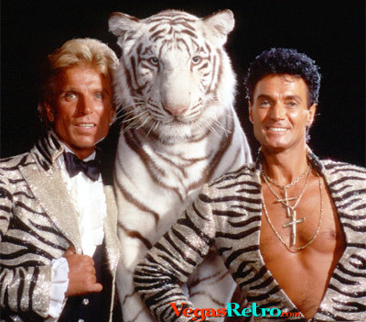
Las Vegas Casino: 4 Black Swan Events
Owner’s daughter kidnapped
Disgruntled construction worker
IRS forms
The star act

Slide 54

A Black Swan Event
A small number of Black Swans explains
The success of ideas and religions
The dynamics of historical events
Elements of our own personal lives
Almost all major scientific discoveries, historical events, and artistic accomplishments
What are some Black Swan Events in the video game industry? (positive or negative)

Slide 55
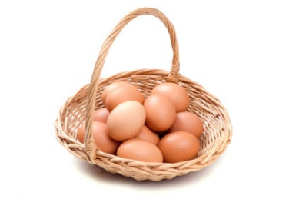
A Black Swan Event: Guarding Against Them…
Redundancy in design of systems
Consider nature and biological systems
Because if you only have one and it fails, then you’re screwed
Don’t put most of your eggs in one basket if it has a very small chance of failing
Imagine you have a high mortgage and a car payment (loaded with debt)
If a Black Swan Event hits you, you’re toast

Slide 56
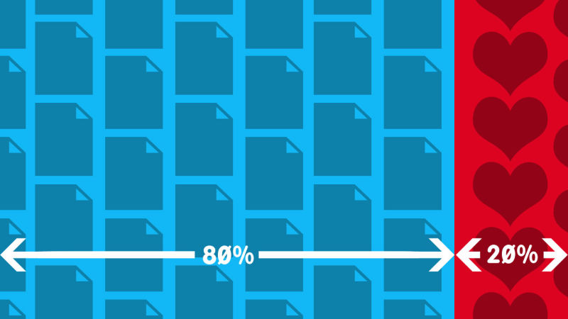
A Black Swan Event: Encouraging Good Ones…
Meet lots of people
Expose yourself to many ideas
Take advantage of opportunities
Take many risks with little downside
Investing in innovation
Google’s 20% time
Venture capitalists (fixed downside, limitless upside)
Hedge 80% on safest path, 20% on risk with huge upside

Slide 57
Back to Your Regularly Scheduled Lecture

Slide 58
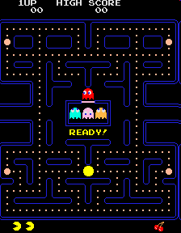
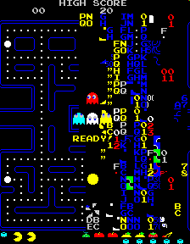
Pac-Man Golden Path
Screen crash at the 256th level...

Slide 59
“Golden Path” Problem
Unintended weaknesses might slip into a shipping game
If weakness is discovered by player, the game is ruined
Also known a “Black Swan”
How can we fix this?

Slide 60
Weakness Modification Learning
Technique developed by Jack van Ryswyck (University of Alberta)
In collaboration with EA Canada for FIFA

Slide 61
Weakness Modification Learning
Problem: Players will repeatedly exploit a weakness
Known as the “Golden Path” problem
Strategy
Determine when a weakness occurs
Next time alter behavior slightly when it looks like it'll happen again
Ensure “history does not repeat itself”
Small change in past results in big change in future

Slide 62
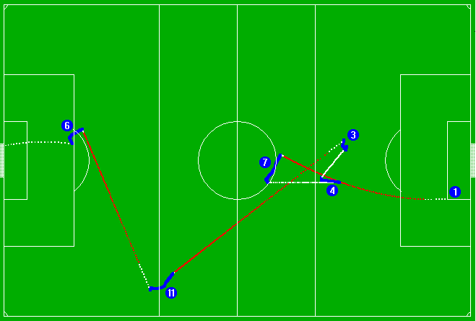

Slide 63
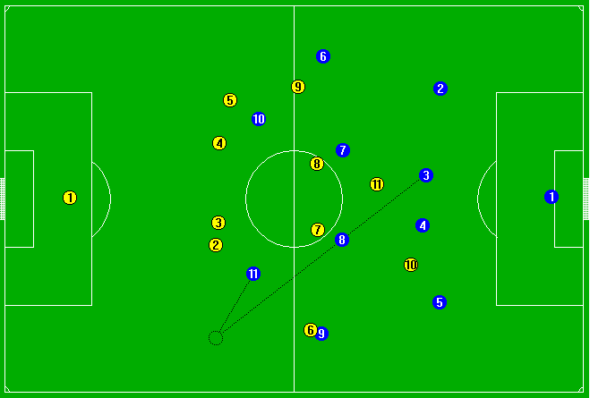

Slide 64
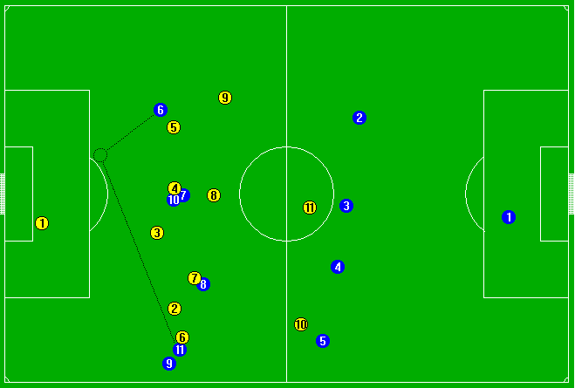

Slide 65
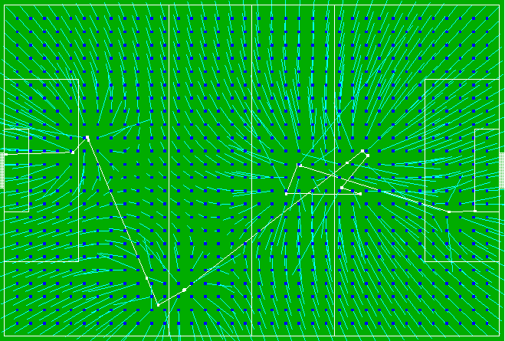

Slide 66
Weakness Modification Learning
AI does not win more often
AI retains behavioral flavor
Does not change large-scale perceived behavior
Learning done with one example!

Slide 67
Actual Golden Path: FIFA 07
“Came across this by accident, when ever u get hold of the ball, don't run/sprint with it just head in the direction of goal the player who is marking u will turn around and run along with u and not attempt to tackle u. leaving u free to run into box and slide it into goal, works every time bar hitting the post or shooting it wide... its that bad your goal keeper can also score... also works on the 360 demo....”
– CheekieMonkiee, GameSpot Forum

Slide 68
Actual Golden Path: Madden 09
“Want to know how to win in Madden 09... EVERY time? Pick Tampa playbook go to shotgun formation.. pick any formation that has HB direct snap. hold right trigger presnap, press button of WR... snap the ball and the receiver will start the play with the ball. u can even snap the ball to the WR when hes in motion.”
– Sonasty

Slide 69
Why so Fragile?
Steve Rabin
GDC AI Summit 2013

Slide 70
In general, is Game AI
Fragile or Robust?

Slide 71


Slide 72
Fragile things don’t like volatility
Fragile things want predictability

Slide 73
Human players are
unpredictable

Slide 74
Linear Gameplay
Constrained Gameplay
“Rails”

Slide 75
Open-ended
sandbox games

Slide 76
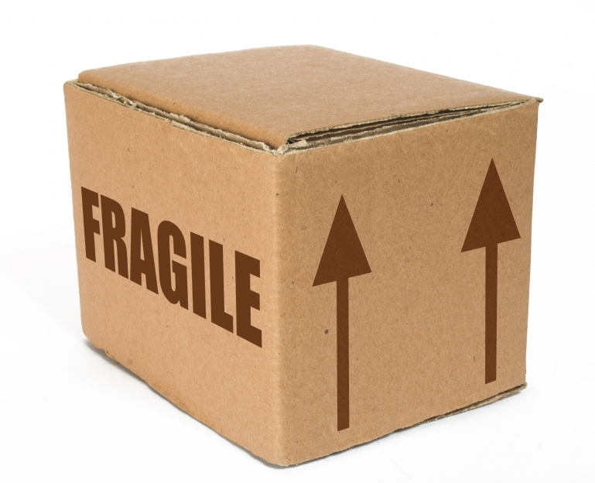
What is the opposite
of fragile?

Slide 77
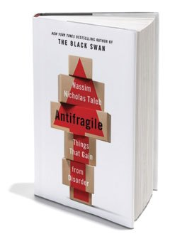
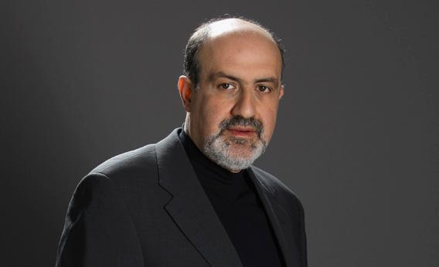

Slide 78
During development
we are Antifragile

Slide 79
After the game
is released?

Slide 80
PATCH

Slide 81
Why is being Antifragile so
difficult to program into AI?

Slide 82
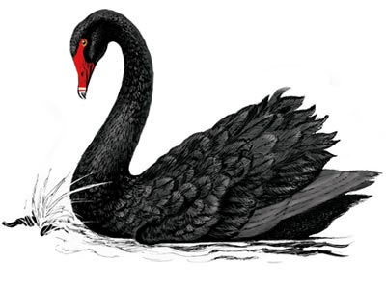

Slide 83
Black Swan Event
Outlier
Extreme Impact
Retrospectively Predictable

Slide 84
Black swan events can’t be predicted

Slide 85
Questions
How do you survive randomness?
How do you survive volatility?
How do you survive Black Swan events?

Slide 86
Antifragile

Slide 87
Muscles are Antifragile

Slide 88
Human Opponents are Antifragile

Slide 89
Fragile
Procedural
Architectures
State
Machines
Robust
Declarative
Architectures
Planning
Goal-Based
Antifragile
Adaptive
Architectures
Player
Modeling

Slide 90

Changing Design Philosophy
From:
Designing a system according to specified performance requirements
To:
Systems that evolve, adapt, and optimize in real-time to adapt functionality and performance to meet the unknown
Morphing Wing, Learn to Fly, Autonomy, Swarming, System Health Management, Self-Healing Materials

Slide 91
“If you are Antifragile, it means you are alive” -Nassim Taleb

Slide 92
Avoid being Fragile
Deliver Robustness
Aspire to be Antifragile

